Slide 1

Name - Ishwa Roll no – S19CSE022 Branch – CSE Semester – 6th Sem Submitted to – Ms. Sonu Sharma

Slide 2

INGFCET PIZZERIA

Slide 3
INDEX
INTRODUCTION
REQUIRENMENT SPECIFICATION
CONTENT IN PROJECT
OBJECTIVE
PURPOSE
SCOPE
ADVANTAGE
OUTPUT WITH CODE
CONCLUSION
REFERENCES

Slide 4
Introduction
The INGFCET Pizzeria System helps the canteen manager to manage the college canteen more effectively and efficiently by computerizing meal ordering, billing and inventory control. This management system is designed for a College Canteen. The system processes transaction and stores the resulting data. Reports will be generated from these data which help the manager to make appropriate business decisions for the canteen.
This will help the canteen owner in many ways such as ordering goods, inventory control, generating bills, managing tables, managing menus, and various customer services.

Slide 5
REQUIREMENT SPECIFICATIONS
Hardware Requirement:
Processor Brand : Intel
Processor Type : Core i5
Processor Speed : 2.40GHz
Ram Size : 8.00 GB

Slide 6
Software Requirement
Operating system : Windows 10
Application Server : Java (NetBeans)
Front end : JAVA
Database connectivity : XAMPP (MYSQL Console)

Slide 7
CONTENT IN PROJECT
Welcome Frame
Home Frame
About Us Frame
Contact Us Frame
Login Frame
Admin Frame
Stock Management Frame
Order Frame
Feedback Frame

Slide 8
Objective
This objective of the project is
To update current canteen systems.
To update current canteen systems.
To simplify and make it easier to manage.
To control every records of canteen.
To manage all the stock.
To check or view every details of canteen.

Slide 9
PURPOSE
The INGFCET Pizzeria System software is specifically designed with features to help operate and manage the canteen.
This system will helps the canteen manager to manage the college canteen more effectively and efficiently by computerizing meal ordering, billing and inventory control.
The aim of the project is to offer variety of food to college students and helps the canteen manager to manage the canteen more effectively and also save his time.

Slide 10
SCOPE
This System will improve business efficiency.
The benefits such as
1. Improve Customer Relationships - it allows canteen manager to modify the menu easily, deduct the waiting time.
2. Tracking Sales – this system helps to make life easy as the canteen manager by tracking all sales data. With the help of this data, you will keep tabs on your items sold. This means it provides the power to make better decisions for your business.
3. Reduction of Errors - Writing down orders for kitchen staff that results in some mistakes being produce due to the handwriting may be illegible. With the help of this software, orders are shown on the screen. Therefore, there is less chance that the person preparing the orders can make errors.
4. Enhanced Productivity – The system handles time-intensive tasks such as price lookups and table distribution. However, it allows your employees to focus on other jobs which help to enhance the business growth and the customer experience.
5. Effective Use of Human Resources - Establishing the system will helps to free up the staff from performing time-consuming tasks.

Slide 11
ADVANTAGE
Safe and secure management system
User friendly
Option for online orders
Free home delivery

Slide 12
OUTPUT WITH SOURCE CODE

Slide 13
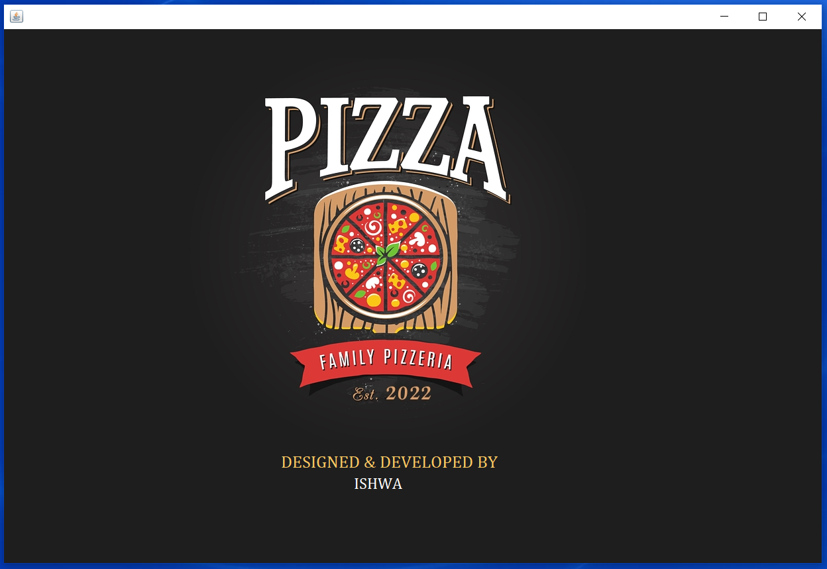
WELCOME PAGE
// WHEN THE PHOTO OR IMAGE IS CLICKED HOME FRAME WILL BE DISPLAYED.
private void HOME_MouseClicked(java.awt.event.MouseEvent evt) {
Home hp=new Home();
hp.setVisible(true);
this.dispose();

Slide 14
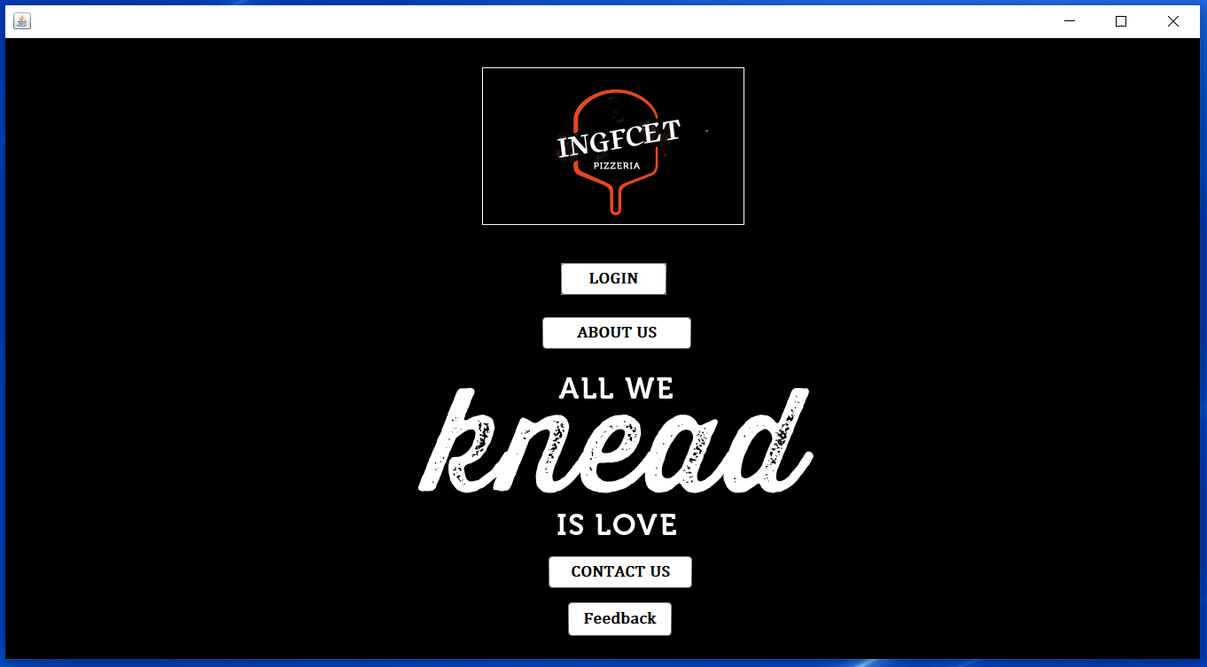
HOME PAGE
// WHEN THE ABOUT US BUTTON IS CLICKED ABOUT US FRAME WILL BE DISPLAYED
private void ABOUT_US_ActionPerformed(java.awt.event.ActionEvent evt) {
About_Us au=new About_Us();
au.setVisible(true);
this.dispose();

Slide 15
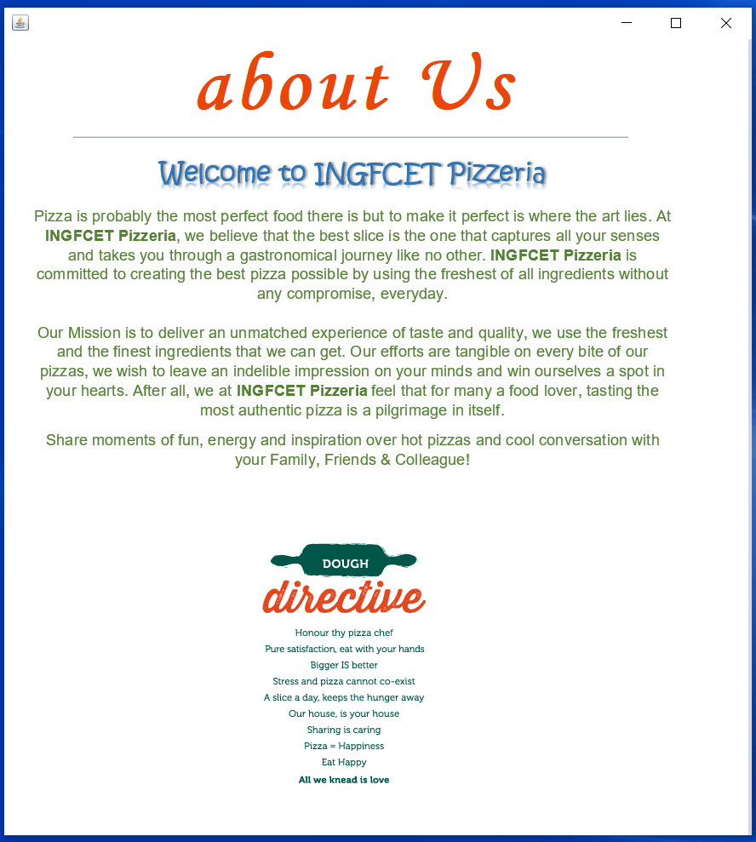
ABOUT US PAGE
private void jLabel1MouseClicked(java.awt.event.MouseEvent evt) {
// WHEN THE PHOTO OR IMAGE IS CLICKED HOME FRAME WILL BE DISPLAYED.
Home hp=new Home();
hp.setVisible(true);
this.dispose();
}

Slide 16
HOME PAGE
private void CONTACT_US_ActionPerformed(java.awt.event.ActionEvent evt) {
// WHEN THE THIS BUTTON IS CLICKED CONTACT US FRAME WILL BE DISPLAYED
Contact_Us cs=new Contact_Us();
cs.setVisible(true);
this.dispose();

Slide 17
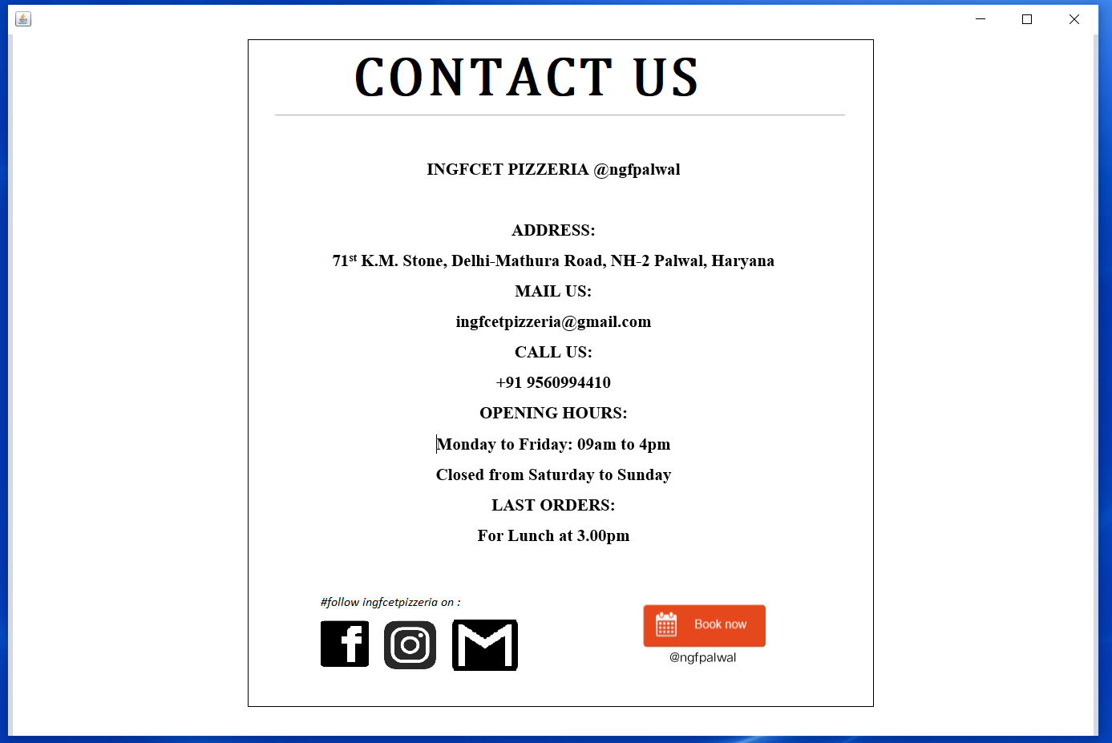
CONTACT US PAGE
private void HOME_MouseClicked(java.awt.event.MouseEvent evt) {
// WHEN BOOK NOW IS CLICKED HOME FRAME WILL BE DISPLAYED.
Home hp=new Home();
hp.setVisible(true);
this.dispose();

Slide 18
HOME PAGE
private void LOGIN_ActionPerformed(java.awt.event.ActionEvent evt) {
// WHEN THE LOGIN BUTTON IS CLICKED LOGIN FRAME WILL BE DISPLAYED
Login l=new Login();
l.setVisible(true);
this.dispose();
private void WELCOM_PAGE_MouseClicked(java.awt.event.MouseEvent evt) {
// WHEN THE BACKGROUND IS CLICKED WELCOME FRAME WILL BE DISPLAYED
WELCOME w=new WELCOME();
w.setVisible(true);
this.dispose();
}

Slide 19
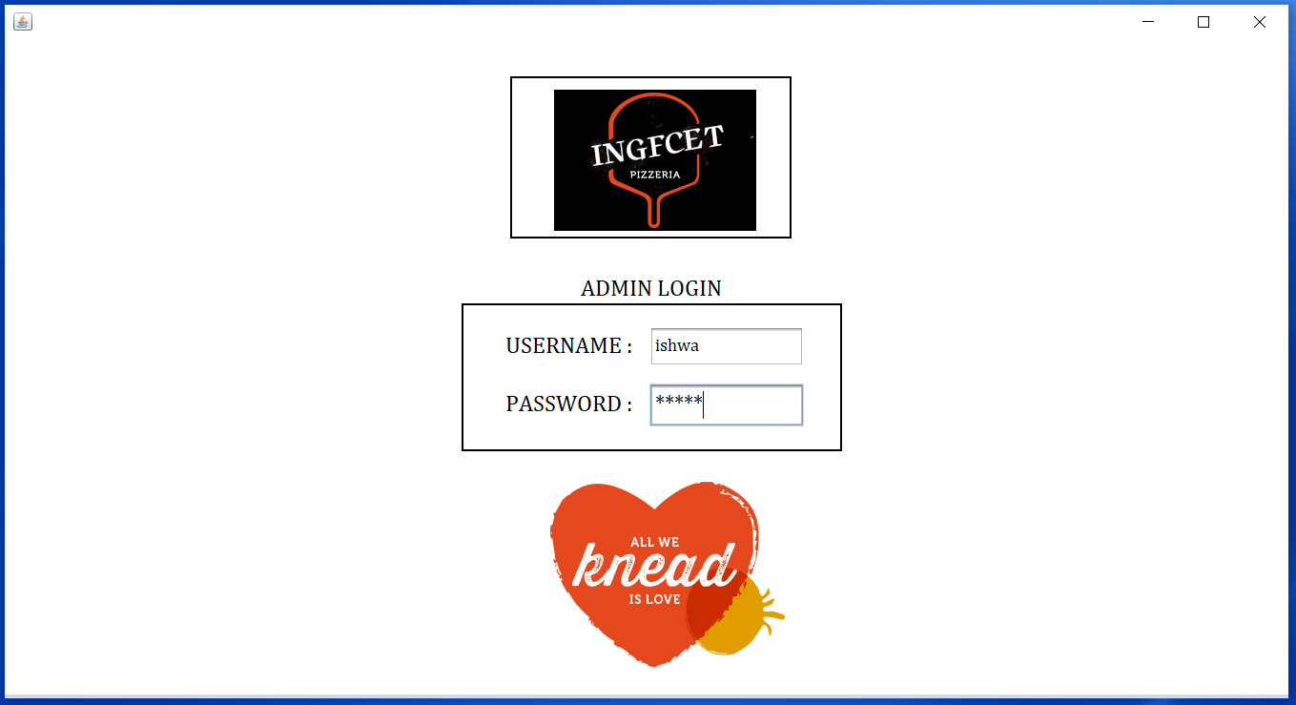
Login
private void LOGIN_MouseClicked(java.awt.event.MouseEvent evt) {
/* WHEN THE PHOTO OR IMAGE IS CLICKED AND IF USERNAME AND PASSWORD IS
CORRECT THEN ADMIN PAGE WILL BE DISPLAYED. */
if (
User_Id.getText().equals("ishwa") &&
Password.getText().equals("ishwa") ||
User_Id.getText().equals("ingfcetp") &&
Password.getText().equals("ingfcetp") ||
)
{
Admin_Page ap=new Admin_Page();
ap.setVisible(true);
this.dispose();
}
else
JOptionPane.showMessageDialog(rootPane,"USERNAME/PASSOWORD IS INCORRECT");
}

Slide 20
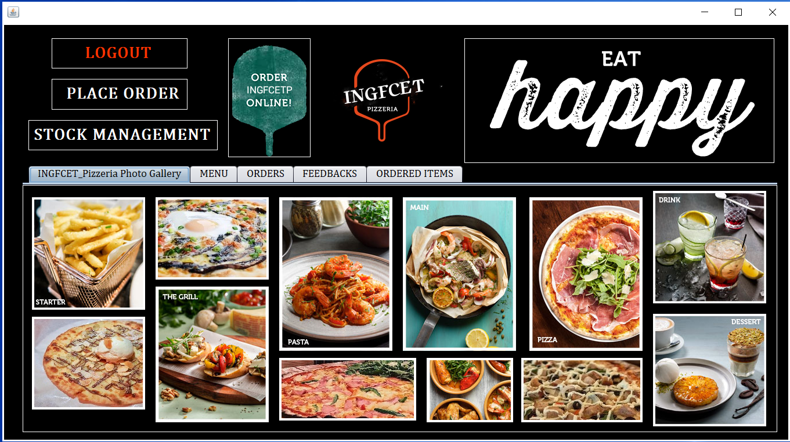
ADMIN
import java.sql.Connection;
import java.sql.DriverManager;
import java.sql.ResultSet;
import java.sql.Statement;
import javax.swing.JOptionPane;
import javax.swing.table.DefaultTableModel;
import java.sql.*;
Connection con;
Statement st;
ResultSet rs;
private void formWindowOpened(java.awt.event.WindowEvent evt) {
// THIS MAKES CONNECTION BETWEEN Net Beans AND MySQL
try
{
//Class.forName("com.mysql.cj.jdbc.Driver");
con=DriverManager.
getConnection("jdbc:mysql://localhost/peperonipizzeria","root","");
st=con.createStatement();
}
catch (Exception e) {System.out.println(e.toString());}
}

Slide 21
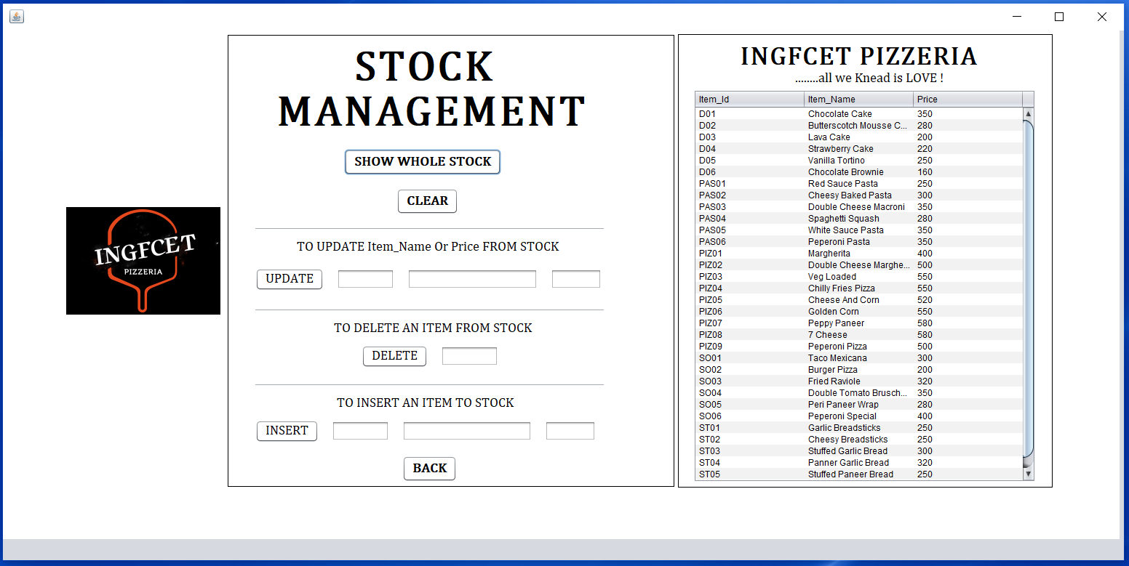
STOCK MANAGEMENT PAGE
import javax.swing.table.DefaultTableModel;
import java.sql.*;
Connection con;
Statement st;
ResultSet rs;
// THIS MAKES CONNECTION BETWEEN Net Beans AND MySQL
private void formWindowOpened(java.awt.event.WindowEvent evt) {
try {
Class.forName("com.mysql.cj.jdbc.Driver");
con=DriverManager.
getConnection("jdbc:mysql://localhost/peperonipizzeria","root","");
st=con.createStatement();
}
catch (Exception e) {System.out.println(e.toString());}
}

Slide 22
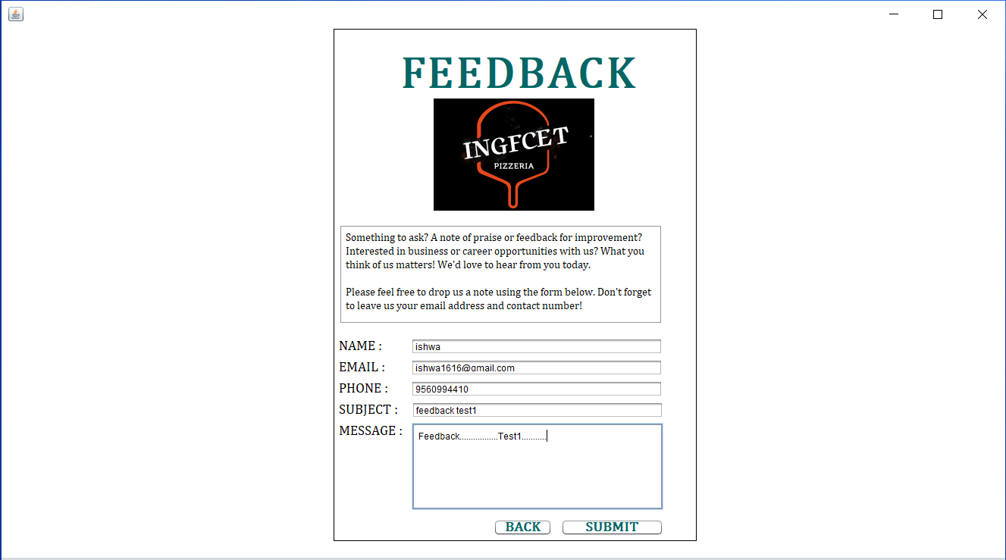
FEEDBACK
import javax.swing.JOptionPane;
import java.sql.*;
import javax.swing.table.DefaultTableModel;
Connection con;
Statement st;
ResultSet rs;
// THIS MAKES CONNECTION BETWEEN Net Beans AND MySQL
private void formWindowOpened(java.awt.event.WindowEvent evt) {
try {
//Class.forName("com.mysql.cj.jdbc.Driver");
con=DriverManager.
getConnection("jdbc:mysql://localhost/peperonipizzeria","root","");
st=con.createStatement();
}
catch (Exception e) {System.out.println(e.toString());}
}

Slide 23
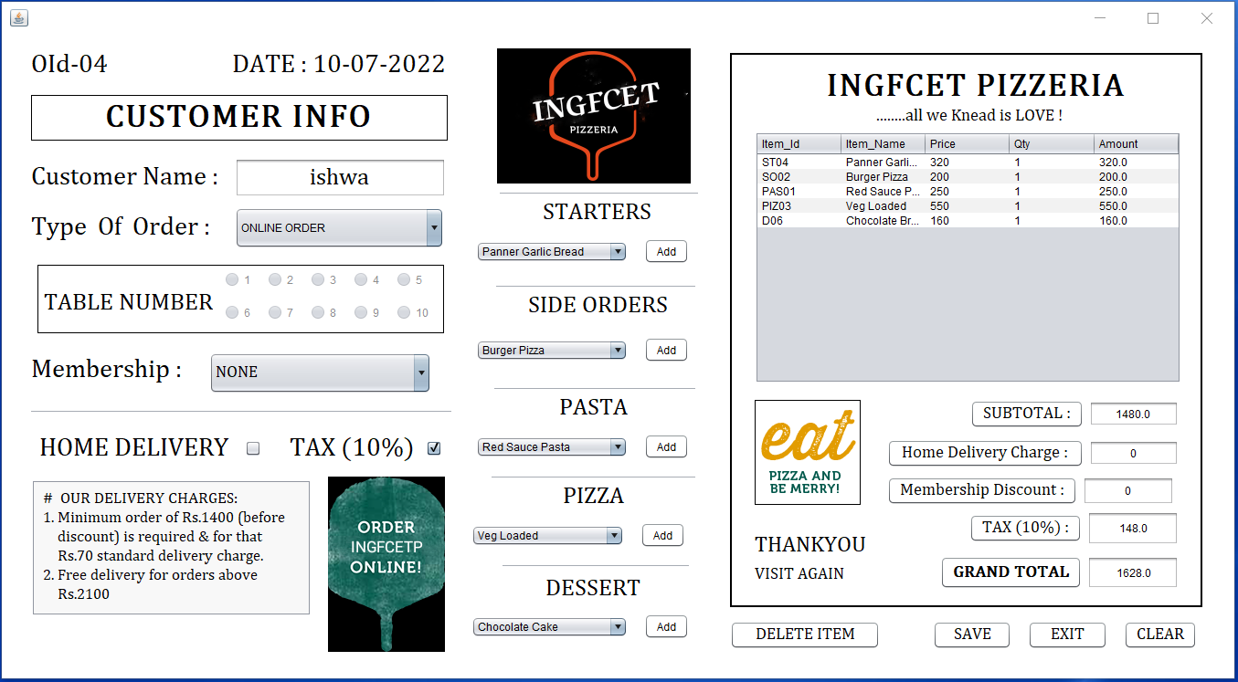
Order
private void SAVE_ActionPerformed(java.awt.event.ActionEvent evt) {
// TO SAVE ALL THE INFORMATION REGARDING ORDER
try
{
Object oid=jLabel25.getText();
String dt=jLabel23.getText();
long d=System.currentTimeMillis();
SimpleDateFormat sdf=new SimpleDateFormat("hh:mm:ss");
String tm=sdf.format(d);
String n=CUSTOMER_NAME_.getText();
Object o=TYPE_OF_ORDER.getSelectedItem();
Object m=MEMBERSHIP_.getSelectedItem();
String hd;
if (HOME_DELIVERY.isSelected())
{
hd="YES";
}
else hd="NO";
String t="YES";
double sb=Double.parseDouble(SUB_TOTAL.getText());
double tc=Double.parseDouble(TAX_.getText());
double hdc=Double.parseDouble(HD_CHARGE_.getText());
double md=Double.parseDouble(MEMBERSHIP_DIS_.getText());
double gt=Double.parseDouble(GRAND_TOTAL_.getText());
st.executeUpdate("insert into orders values('"+oid+"','"+dt+"','"+tm+
"','"+n+"' ,'"+o+"', '"+m+"','"+hd+"','"+t+"', '"+sb+
"','"+tc+"','"+hdc+"','"+md+"','"+gt+"');");
}
catch (Exception e) {System.out.println(e.toString());}

Slide 24
CONCLUSION
The INGFCET Pizzeria System helps the canteen manager to manage the college canteen more effectively and efficiently by computerizing meal ordering, billing and inventory control. This management system is designed for a College Canteen. The system processes transaction and stores the resulting data. Reports will be generated from these data which help the manager to make appropriate business decisions for the canteen.
This will helps the canteen owner to modify the menu easily, deduct the waiting time, helps to make life easy as the canteen by tracking all sales data, by reducing the errors, enhanced and effective Use of Human resources
Helps the canteen owner to free up the staff from performing time-consuming tasks.

Slide 25

“INGFCET
Pizzeria
Welcomes You!”

Slide 26
REFERENCE
http://peperoni.com.sg/
www.google.com
www.youtube.com

Slide 27
THANK YOU

